Slide 1
Pro Bono Legal Aid Work at
Gujarat National
Law University, Gandhinagar
Dr. Kalpeshkumar L Gupta
Assistant Professor
Gujarat National Law University, Gandhinagar
kgupta@gnlu.ac.in
National Seminar on Law School Based Legal Services Clinics
Organized by
NALSA, New Delhi
Sunday, July 30, 2017

Slide 2
Outline
About Gujarat National Law University
Contribution of GNLU in Legal & Awareness Initiatives
Survey of Pro Bono Legal Aid in GNLU
The way forward

Slide 3
Outline
About Gujarat National Law University
Contribution of GNLU in Legal & Awareness Initiatives
Survey of Pro Bono Legal Aid in GNLU
The way forward

Slide 4
About Gujarat National Law University
GNLU established under Gujarat National Law University Act, 2003.
Member of Association of Indian Universities, United Nations Academic Impact, International Association of Law Schools, Asian Law Institute, Shastri Indo-Canadian Institute.
Listed in top 10 law schools in India.
Courses BA/B.Com./BBA/B.Sc./BSW/LL.B., LL.M., MBA, Ph.D.
50+ faculty members.
1000+ students.
5 Deans – Academics, Research, Extension, Training & Student Welfare.
Research Based Teaching University (RBTU).

Slide 5
Outline
About Gujarat National Law University
Contribution of GNLU in Legal & Awareness Initiatives
Survey of Pro Bono Legal Aid in GNLU
The way forward

Slide 6
Contribution of GNLU in Legal Aid & Awareness Initiatives
GNLU Centre for Law & Society oversees the all legal aid and awareness initiatives.
Pro Bono Legal Aid Programme is executed by Legal Services Committee (LSC) & Alternate Dispute Resolution (ADR) Cell.
20 hours mandatory pro bono work in a academic year. Total 100 hours in five years course.
With effect from Batch 2015.
Submission of Activity Report.
LSC/ADR Cell will issue a completion certificate.
Launched Pro Bono Legal Award in year 2016 (Criteria – Number of Hours, Nature of Work).
Till date 360+ students have successfully provided their pro bono services.

Slide 7
Contribution of GNLU in Legal Aid & Awareness Initiatives
GNLU
Centre For Law & Society
Law & Society Wing
Legal Services Committee
Sensitization Team
Pro Bono Team
Socio-Legal Research
Legal Aid Clinic
Sensitization on various laws
Monitor & Facilitate Pro Bono Legal Aid Work

Slide 8
Contribution of GNLU in Legal Aid & Awareness Initiatives
Pro Bono Activities Involved
Providing free and competent legal services to the eligible persons and institutions;
Organizing legal awareness camps and services in the rural areas;
Providing assistance through diverse methods, including traditional casework, self-help and community legal education;
Conducting legal literacy, educational activities and awareness programmes;
To make litigation free villages and institutions;
To organise lok adalats for amicable settlement of disputes etc.

Slide 9
Contribution of GNLU in Legal Aid & Awareness Initiatives
Pro Bono Legal Aid Work Award
To acknowledge pro bono work carried out by the students, GNLU introduced the Annual Pro Bono Legal Aid Award in year 2016, so as to enhance and motivate the students for contributing to the society at large.

Slide 10
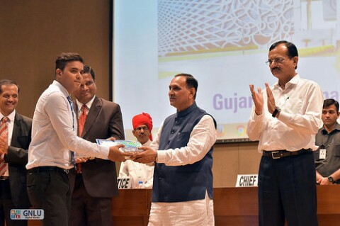
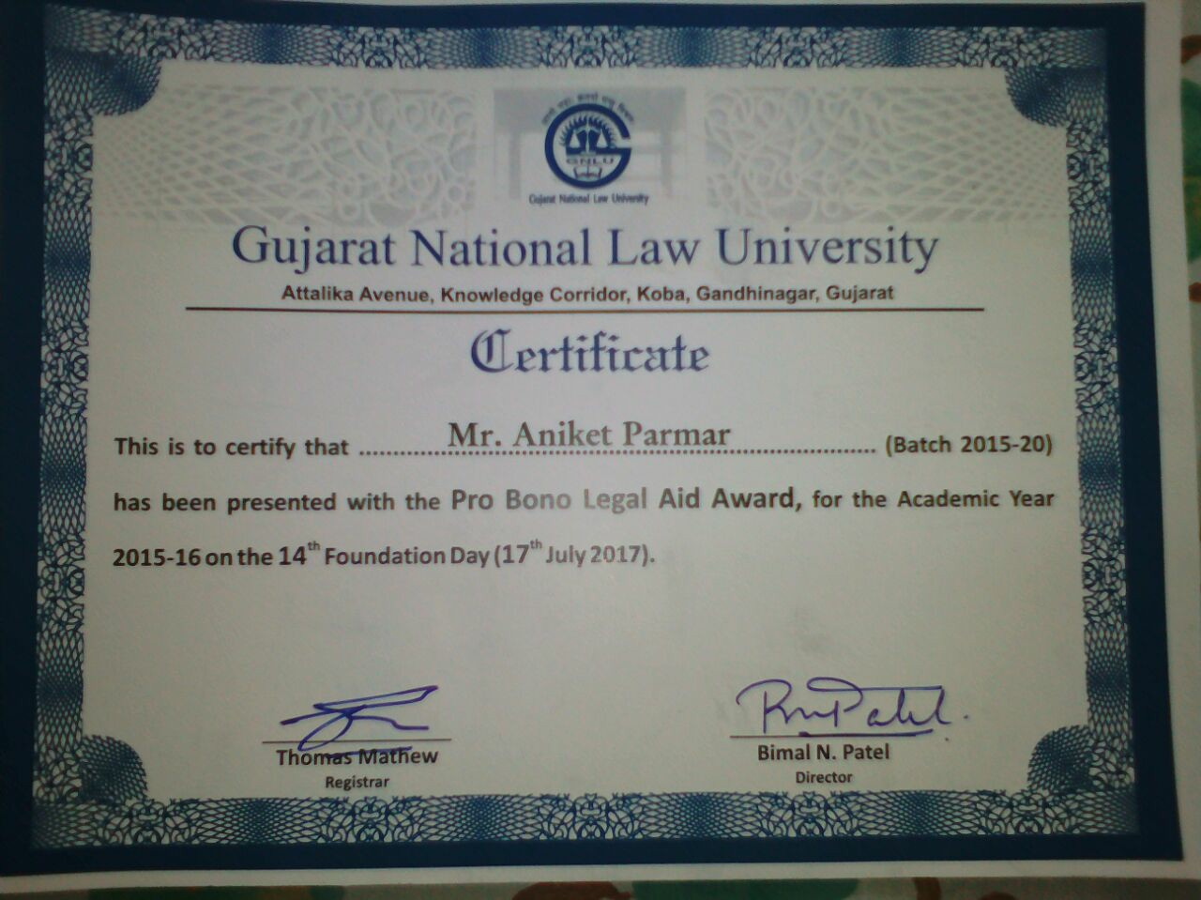
Contribution of GNLU in Legal Aid & Awareness Initiatives
Pro Bono Legal Aid Work Award
Pro Bono Legal Aid Award 2017
Aniket Parmar (Batch 2015-20)

Slide 11
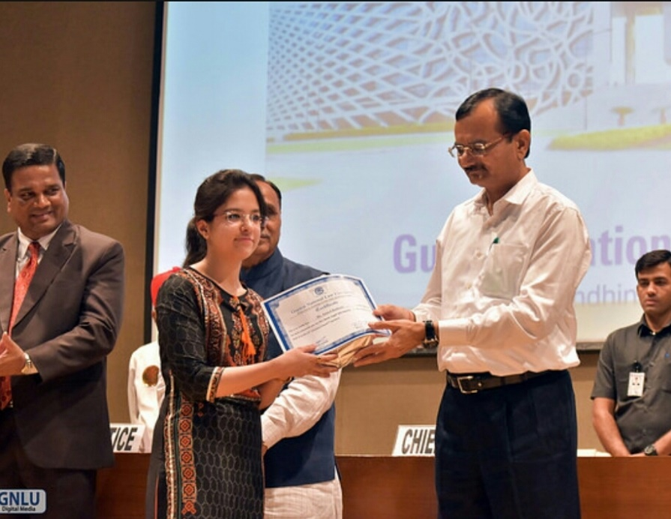
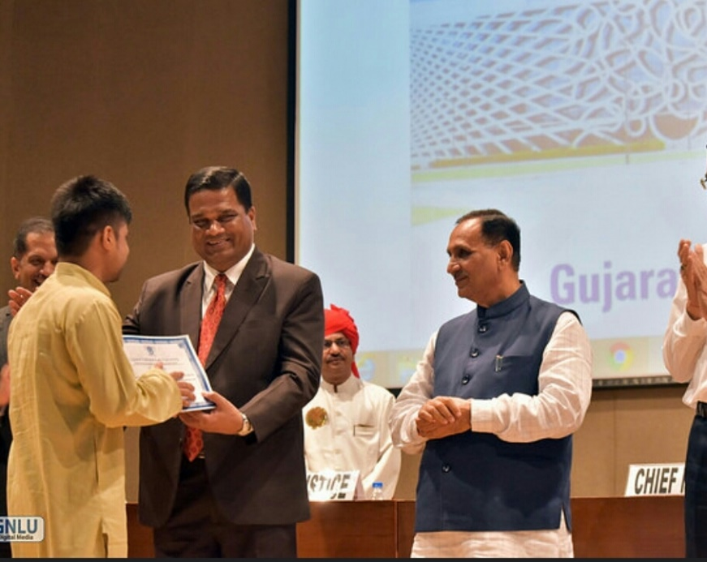
Contribution of GNLU in Legal Aid & Awareness Initiatives
Pro Bono Legal Aid Work Award
Anmol Rathore
Neep Saikia

Slide 12
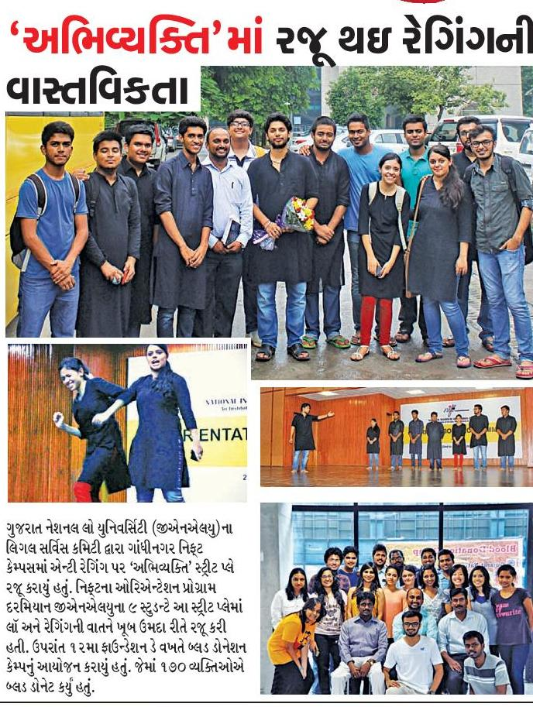

Slide 13
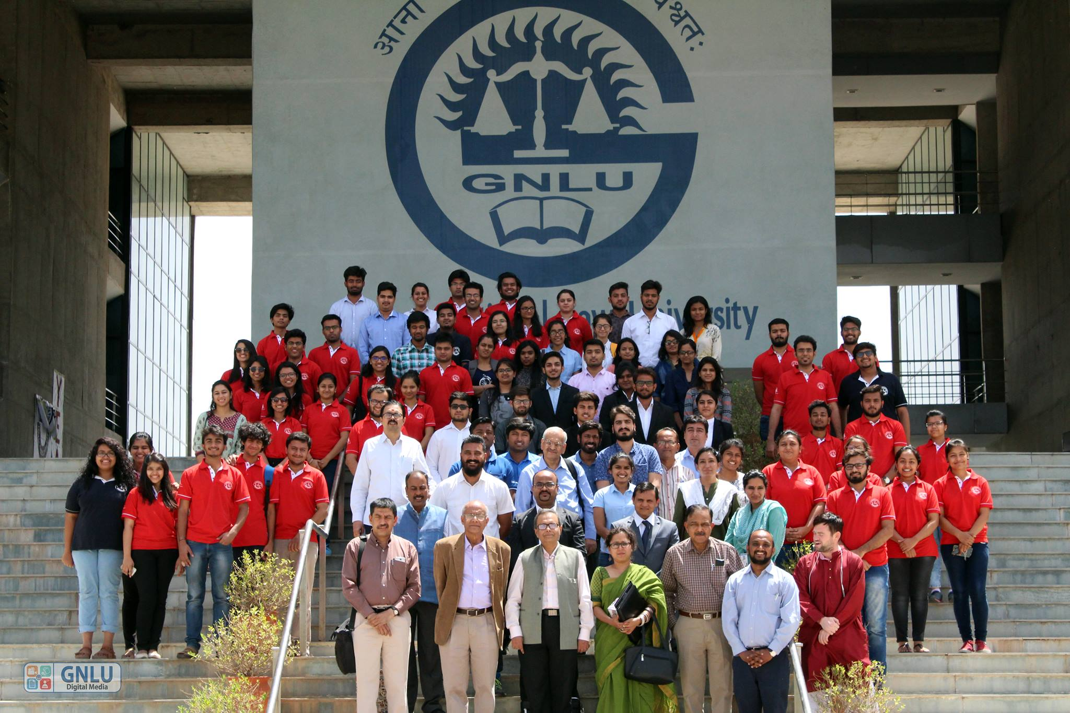
2nd Interlinking National Conference on Legal Services Committee 2017

Slide 14
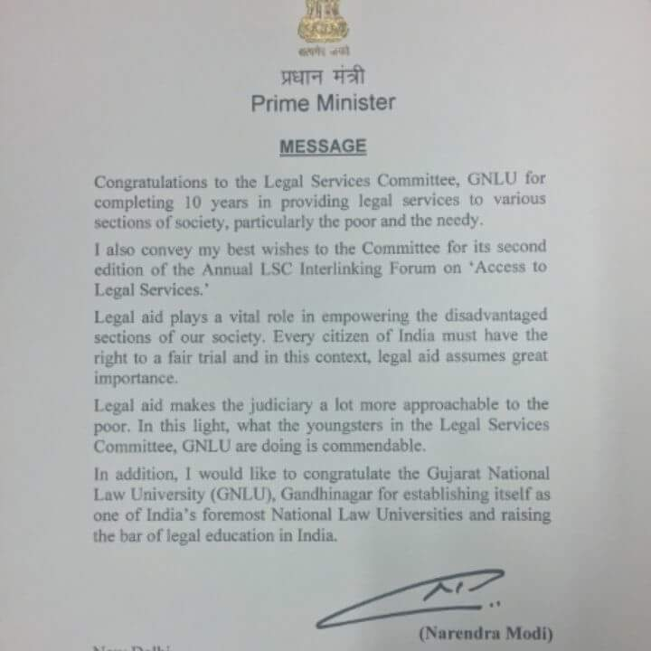

Slide 15
Outline
About Gujarat National Law University
Contribution of GNLU in Legal & Awareness Initiatives
Survey of Pro Bono Legal Aid in GNLU
The way forward

Slide 16
Survey of Pro Bono Legal Aid in GNLU
Respondent Profile | Total | %
Law Teachers | 29 (Includes 3 from GNLU) | 21
Law Students | 105 (Includes 87 from GNLU) | 77
Others | 3 | 2
Total | 137 (Includes 90 from GNLU) | 100%

Slide 17
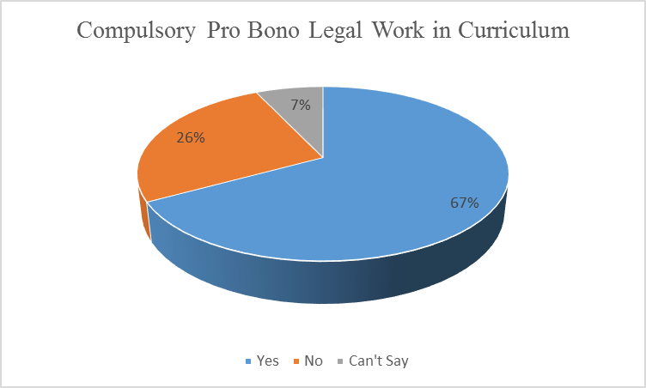
Survey of Pro Bono Legal Aid in GNLU

Slide 18
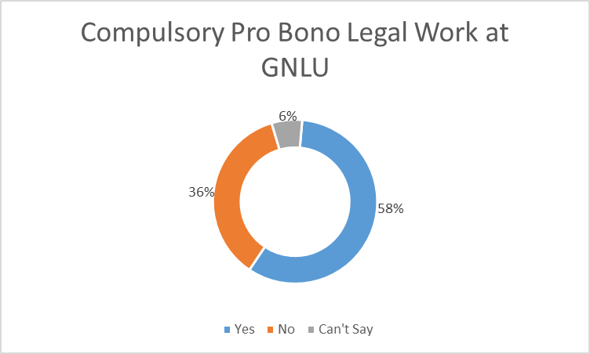
Survey of Pro Bono Legal Aid in GNLU

Slide 19
Survey of Pro Bono Legal Aid in GNLU
Average Hrs. (Per Academic Year) | Total
Minimum | 17
Maximum | 24

Slide 20
Survey of Pro Bono Legal Aid in GNLU
Remarks – In Favour of Compulsory Pro Bono Legal Aid
Should be made compulsory for law colleges and legal professionals.
It gives students practical experience of law and its applicability.
Greater tie ups of law colleges with NGOs should be there.
Bar Council of India should make Pro Bono work mandatory for students in law schools.
Should be like medical college internship.
Pro Bono exposes our minds to the various social issues and calls for our attention on it.
Pro Bono work provides a sense of satisfaction.
It gives a new perspective to the student to think towards the upliftment of all, Sarvodaya.

Slide 21
Survey of Pro Bono Legal Aid in GNLU
Remarks – Not in favour of Compulsory Pro Bono Legal Aid
It’s unnecessary.
Initiate legal aid for final year project of law students.
Pro Bono work should have different specialized cells according to work (Research related, advising & consultancy) and also according to subject (environment law, civil, criminal etc.)
It should be a matter of choice and not compulsion.
If a college makes pro bono compulsory, it should have less stringent rules about it.
Fake pro bono certificates should be curbed.
Students resort to unethical means.
Should be linked with academic credit.
Structured probono work planning.

Slide 22
Outline
About Gujarat National Law University
Contribution of GNLU in Legal & Awareness Initiatives
Survey of Pro Bono Legal Aid in GNLU
The way forward

Slide 23
The way forward
Make compulsory pro bono legal aid as a part of curriculum.
Bar Council of India should come up with policy in this regard in consultation with law schools around the India.
Law teachers should include pro bono legal aid activities in their respective subjects.
Collaborative effort for legal aid and awareness initiatives (e.g. GNLU LSC Interlinking Conference).

Slide 24
STAY CONNECTED
Mr. Saurabh Anand,
Director, GNLU Centre for Law & Society
http://gnlucls.weebly.com/ & http://gnlu.ac.in/
/GNLUCLS/
+91 81286 50876, +91 99247 76900
gcls@gnlu.ac.in, legalservices@gnlu.ac.in

